Slide 1
CSC 2310 Object Oriented Programming & Design Chapter 6
Dr. Shah Alam

Slide 2
Introduction to Arrays
An array is a data structure used to process a collection of data that is all of the same type
An array behaves like a numbered list of variables with a uniform naming mechanism
It has a part that does not change: the name of the array
It has a part that can change: an integer in square brackets
For example, given five scores:
score[0], score[1], score[2], score[3], score[4]

Slide 3
Creating and Accessing Arrays
An array that behaves like this collection of variables, all of type double, can be created using one statement as follows:
double[] score = new double[5];
Or using two statements:
double[] score;
score = new double[5];
The first statement declares the variable score to be of the array type double[]
The second statement creates an array with five numbered variables of type double and makes the variable score a name for the array

Slide 4
Creating and Accessing Arrays
The individual variables that together make up the array are called indexed variables
They can also be called subscripted variables or elements of the array
The number in square brackets is called an index or subscript
In Java, indices must be numbered starting with 0, and nothing else
score[0], score[1], score[2], score[3], score[4]

Slide 5
Creating and Accessing Arrays
The number of indexed variables in an array is called the length or size of the array
When an array is created, the length of the array is given in square brackets after the array type
The indexed variables are then numbered starting with 0, and ending with the integer that is one less than the length of the array
score[0], score[1], score[2], score[3], score[4]

Slide 6
Creating and Accessing Arrays
double[] score = new double[5];
A variable may be used in place of the integer (i.e., in place of the integer 5 above)
The value of this variable can then be read from the keyboard
This enables the size of the array to be determined when the program is run
double[] score = new double[count];
An array can have indexed variables of any type, including any class type
All of the indexed variables in a single array must be of the same type, called the base type of the array

Slide 7
Declaring and Creating an Array
An array is declared and created in almost the same way that objects are declared and created:
BaseType[] ArrayName = new BaseType[size];
The size may be given as an expression that evaluates to a nonnegative integer, for example, an int variable
char[] line = new char[80];
double[] reading = new double[count];
Person[] specimen = new Person[100];

Slide 8
Referring to Arrays and Array Elements
Each array element can be used just like any other single variable by referring to it using an indexed expression: score[0]
The array itself (i.e., the entire collection of indexed variables) can be referred to using the array name (without any square brackets): score
An array index can be computed when a program is run
It may be represented by a variable: score[index]
It may be represented by an expression that evaluates to a suitable integer: score[next + 1]

Slide 9
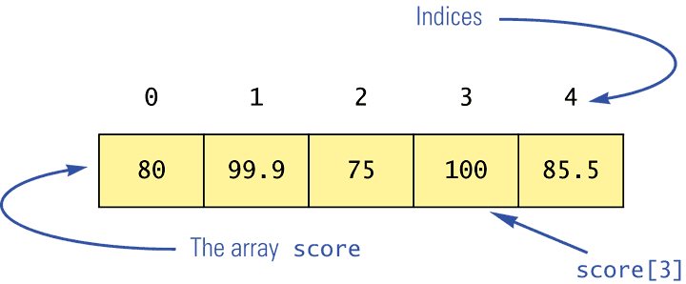
Using the score Array in a Program
The for loop is ideally suited for performing array manipulations:
for (index = 0; index < 5; index++)
System.out.println(score[index] +
" differs from max by " +
(max-score[index]) );

Slide 10
Three Ways to Use Square Brackets [] with an Array Name
Square brackets can be used to create a type name:
double[] score;
Square brackets can be used with an integer value as part of the special syntax Java uses to create a new array:
score = new double[5];
Square brackets can be used to name an indexed variable of an array:
max = score[0];

Slide 11
The length Instance Variable
An array is considered to be an object
Since other objects can have instance variables, so can arrays
Every array has exactly one instance variable named length
When an array is created, the instance variable length is automatically set equal to its size
The value of length cannot be changed (other than by creating an entirely new array with new)
double[] score = new double[5];
Given score above, score.length has a value of 5

Slide 12
Pitfall: Array Index Out of Bounds
Array indices always start with 0, and always end with the integer that is one less than the size of the array
The most common programming error made when using arrays is attempting to use a nonexistent array index
When an index expression evaluates to some value other than those allowed by the array declaration, the index is said to be out of bounds
An out of bounds index will cause a program to terminate with a run-time error message
Array indices get out of bounds most commonly at the first or last iteration of a loop that processes the array: Be sure to test for this!

Slide 13
Initializing Arrays
An array can be initialized when it is declared
Values for the indexed variables are enclosed in braces, and separated by commas
The array size is automatically set to the number of values in the braces
int[] age = {2, 12, 1};
Given age above, age.length has a value of 3

Slide 14
Initializing Arrays
Another way of initializing an array is by using a for loop
double[] reading = new double[100];
int index;
for (index = 0;
index < reading.length; index++)
reading[index] = 42.0;
If the elements of an array are not initialized explicitly, they will automatically be initialized to the default value for their base type

Slide 15
Pitfall: An Array of Characters Is Not a String
An array of characters is conceptually a list of characters, and so is conceptually like a string
However, an array of characters is not an object of the class String
char[] a = {'A', 'B', 'C'};
String s = a; //Illegal!
An array of characters can be converted to an object of type String, however

Slide 16
Pitfall: An Array of Characters Is Not a String
The class String has a constructor that has a single parameter of type char[]
String s = new String(a);
The object s will have the same sequence of characters as the entire array a ("ABC"), but is an independent copy
Another String constructor uses a subrange of a character array instead
String s2 = new String(a,0,2);
Given a as before, the new string object is "AB"

Slide 17
Pitfall: An Array of Characters Is Not a String
An array of characters does have some things in common with String objects
For example, an array of characters can be output using println
System.out.println(a);
Given a as before, this would produce the output
ABC

Slide 18
Arrays and References
Like class types, a variable of an array type holds a reference
Arrays are objects
A variable of an array type holds the address of where the array object is stored in memory
Array types are (usually) considered to be class types

Slide 19
Arrays are Objects
An array can be viewed as a collection of indexed variables
An array can also be viewed as a single item whose value is a collection of values of a base type
An array variable names the array as a single item
double[] a;
A new expression creates an array object and stores the object in memory
new double[10]
An assignment statement places a reference to the memory address of an array object in the array variable
a = new double[10];

Slide 20
Arrays Are Objects
The previous steps can be combined into one statement
double[] a = new double[10];
Note that the new expression that creates an array invokes a constructor that uses a nonstandard syntax
Not also that as a result of the assignment statement above, a contains a single value: a memory address or reference
Since an array is a reference type, the behavior of arrays with respect to assignment (=), equality testing (==), and parameter passing are the same as that described for classes

Slide 21
Pitfall: Arrays with a Class Base Type
The base type of an array can be a class type
Date[] holidayList = new Date[20];
The above example creates 20 indexed variables of type Date
It does not create 20 objects of the class Date
Each of these indexed variables are automatically initialized to null
Any attempt to reference any them at this point would result in a "null pointer exception" error message

Slide 22
Pitfall: Arrays with a Class Base Type
Like any other object, each of the indexed variables requires a separate invocation of a constructor using new (singly, or perhaps using a for loop) to create an object to reference
holidayList[0] = new Date();
. . .
holidayList[19] = new Date();
OR
for (int i = 0; i < holidayList.length; i++)
holidayList[i] = new Date();
Each of the indexed variables can now be referenced since each holds the memory address of a Date object

Slide 23
Array Parameters
Both array indexed variables and entire arrays can be used as arguments to methods
An indexed variable can be an argument to a method in exactly the same way that any variable of the array base type can be an argument

Slide 24
Array Parameters
double n = 0.0;
double[] a = new double[10];//all elements
//are initialized to 0.0
int i = 3;
Given myMethod which takes one argument of type double, then all of the following are legal:
myMethod(n);//n evaluates to 0.0
myMethod(a[3]);//a[3] evaluates to 0.0
myMethod(a[i]);//i evaluates to 3,
//a[3] evaluates to 0.0

Slide 25
Array Parameters
An argument to a method may be an entire array
Array arguments behave like objects of a class
Therefore, a method can change the values stored in the indexed variables of an array argument
A method with an array parameter must specify the base type of the array only
BaseType[]
It does not specify the length of the array

Slide 26
Array Parameters
The following method, doubleElements, specifies an array of double as its single argument:
public class SampleClass
{
public static void doubleElements(double[] a)
{
int i;
for (i = 0; i < a.length; i++)
a[i] = a[i]*2;
. . .
}
. . .
}

Slide 27
Array Parameters
Arrays of double may be defined as follows:
double[] a = new double[10];
double[] b = new double[30];
Given the arrays above, the method doubleElements from class SampleClass can be invoked as follows:
SampleClass.doubleElements(a);
SampleClass.doubleElements(b);
Note that no square brackets are used when an entire array is given as an argument
Note also that a method that specifies an array for a parameter can take an array of any length as an argument

Slide 28
Pitfall: Use of = and == with Arrays
Because an array variable contains the memory address of the array it names, the assignment operator (=) only copies this memory address
It does not copy the values of each indexed variable
Using the assignment operator will make two array variables be different names for the same array
b = a;
The memory address in a is now the same as the memory address in b: They reference the same array

Slide 29
Pitfall: Use of = and == with Arrays
A for loop is usually used to make two different arrays have the same values in each indexed position:
int i;
for (i = 0;
(i < a.length) && (i < b.length); i++)
b[i] = a[i];
Note that the above code will not make b an exact copy of a, unless a and b have the same length

Slide 30
Pitfall: Use of = and == with Arrays
For the same reason, the equality operator (==) only tests two arrays to see if they are stored in the same location in the computer's memory
It does not test two arrays to see if they contain the same values
(a == b)
The result of the above boolean expression will be true if a and b share the same memory address (and, therefore, reference the same array), and false otherwise

Slide 31
Pitfall: Use of = and == with Arrays
In the same way that an equals method can be defined for a class, an equalsArray method can be defined for a type of array
This is how two arrays must be tested to see if they contain the same elements
The following method tests two integer arrays to see if they contain the same integer values

Slide 32
Pitfall: Use of = and == with Arrays
public static boolean equalsArray(int[] a, int[] b)
{
if (a.length != b.length) return false;
else
{
int i = 0;
while (i < a.length)
{
if (a[i] != b[i])
return false;
i++;
}
}
return true;
}

Slide 33
Arguments for the Method main
The heading for the main method of a program has a parameter for an array of String
It is usually called args by convention
public static void main(String[] args)
Note that since args is a parameter, it could be replaced by any other non-keyword identifier
If a Java program is run without giving an argument to main, then a default empty array of strings is automatically provided

Slide 34
Arguments for the Method main
Here is a program that expects three string arguments:
public class SomeProgram
{
public static void main(String[] args)
{
System.out.println(args[0] + " " +
args[2] + args[1]);
}
}
Note that if it needed numbers, it would have to convert them from strings first

Slide 35
Arguments for the Method main
If a program requires that the main method be provided an array of strings argument, each element must be provided from the command line when the program is run
java SomeProgram Hi ! there
This will set args[0] to "Hi", args[1] to "!", and args[2] to "there"
It will also set args.length to 3
When SomeProgram is run as shown, its output will be:
Hi there!

Slide 36
Methods That Return an Array
In Java, a method may also return an array
The return type is specified in the same way that an array parameter is specified
public static int[]
incrementArray(int[] a, int increment)
{
int[] temp = new int[a.length];
int i;
for (i = 0; i < a.length; i++)
temp[i] = a[i] + increment;
return temp;
}

Slide 37
Privacy Leaks with Array Instance Variables
If an accessor method does return the contents of an array, special care must be taken
Just as when an accessor returns a reference to any private object
public double[] getArray()
{
return anArray;//BAD!
}
The example above will result in a privacy leak

Slide 38
Privacy Leaks with Array Instance Variables
The previous accessor method would simply return a reference to the array anArray itself
Instead, an accessor method should return a reference to a deep copy of the private array object
Below, both a and count are instance variables of the class containing the getArray method
public double[] getArray()
{
double[] temp = new double[count];
for (int i = 0; i < count; i++)
temp[i] = a[i];
return temp
}

Slide 39
Privacy Leaks with Array Instance Variables
If a private instance variable is an array that has a class as its base type, then copies must be made of each class object in the array when the array is copied:
public ClassType[] getArray()
{
ClassType[] temp = new ClassType[count];
for (int i = 0; i < count; i++)
temp[i] = new ClassType(someArray[i]);
return temp;
}

Slide 40
The ArrayList Class (1 of 3)
ArrayList is a class in the standard Java libraries
Unlike arrays, which have a fixed length once they have been created, an ArrayList is an object that can grow and shrink while your program is running
In general, an ArrayList serves the same purpose as an array, except that an ArrayList can change length while the program is running

Slide 41
The ArrayList Class (2 of 3)
The class ArrayList is implemented using an array as a private instance variable
When this hidden array is full, a new larger hidden array is created and the data is transferred to this new array

Slide 42
The ArrayList Class (3 of 3)
Why not always use an ArrayList instead of an array?
An ArrayList is less efficient than an array
It does not have the convenient square bracket notation
The base type of an ArrayList must be a class type (or other reference type): it cannot be a primitive type
This last point is less of a problem now that Java provides automatic boxing and unboxing of primitives

Slide 43
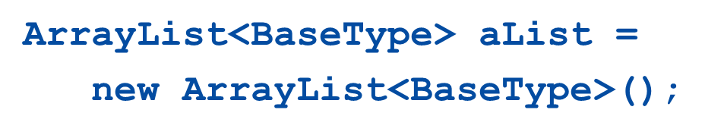
Using the ArrayList Class (1 of 4)
In order to make use of the ArrayList class, it must first be imported from the package java.util
An ArrayList is created and named in the same way as object of any class, except that you specify the base type as follows:

Slide 44
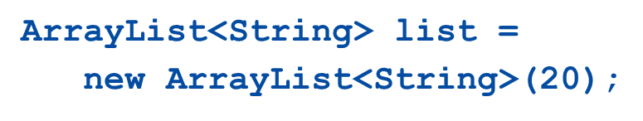
Using the ArrayList Class (2 of 4)
An initial capacity can be specified when creating an ArrayList as well
The following code creates an ArrayList that stores objects of the base type String with an initial capacity of 20 items
Specifying an initial capacity does not limit the size to which an ArrayList can eventually grow
Note that the base type of an ArrayList is specified as a type parameter

Slide 45

Using the ArrayList Class (3 of 4)
The add method is used to set an element for the first time in an ArrayList
The method name add is overloaded
There is also a two argument version that allows an item to be added at any currently used index position or at the first unused position

Slide 46
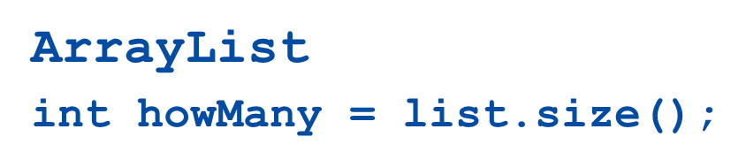
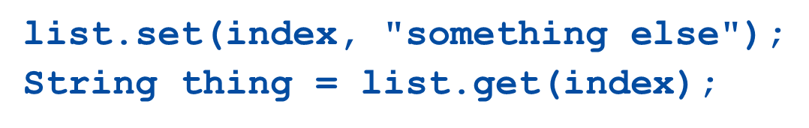
Using the ArrayList Class (4 of 4)
The size method is used to find out how many indices already have elements in the ArrayList
The set method is used to replace any existing element, and the get method is used to access the value of any existing element

Slide 47
Tip: Summary of Adding to an ArrayList (1 of 3)
The add method is usually used to place an element in an ArrayList position for the first time (at an ArrayList index)
The simplest add method has a single parameter for the element to be added, and adds an element at the next unused index, in order

Slide 48
Tip: Summary of Adding to an ArrayList (2 of 3)
An element can be added at an already occupied list position by using the two-parameter version of add
This causes the new element to be placed at the index specified, and every other member of the ArrayList to be moved up by one position

Slide 49
Tip: Summary of Adding to an ArrayList (3 of 3)
The two-argument version of add can also be used to add an element at the first unused position (if that position is known)
Any individual element can be changed using the set method
However, set can only reset an element at an index that already contains an element
In addition, the method size can be used to determine how many elements are stored in an ArrayList

Slide 50
Methods in the Class ArrayList (1 of 12)
The tools for manipulating arrays consist only of the square brackets and the instance variable length
ArrayLists, however, come with a selection of powerful methods that can do many of the things for which code would have to be written in order to do them using arrays

Slide 51
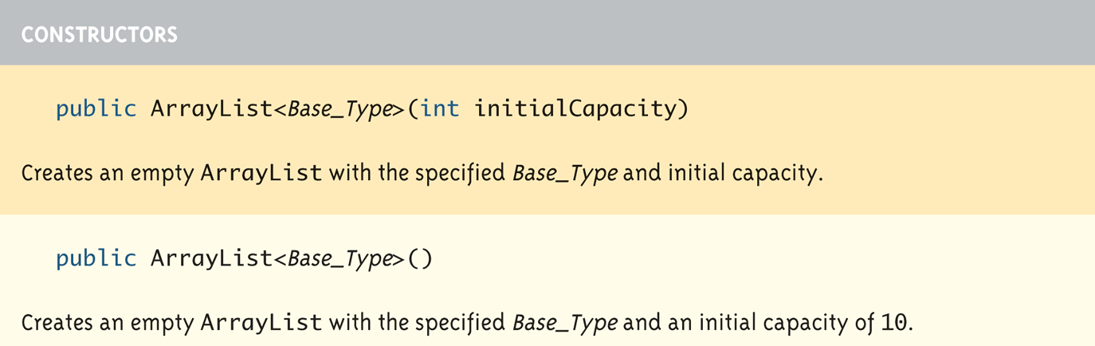
Methods in the Class ArrayList (2 of 12)
Display 14.1 Some Methods in the Class ArrayList

Slide 52
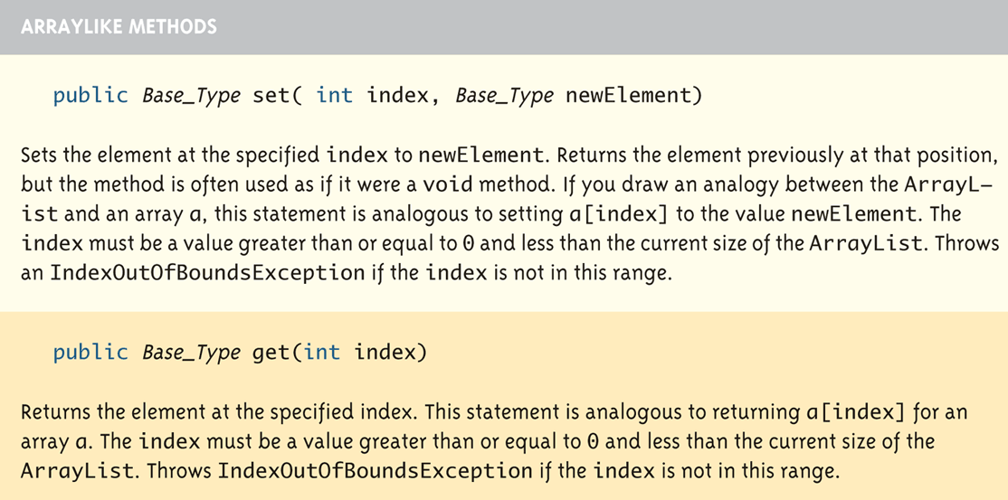
Methods in the Class ArrayList (3 of 12)
Display 14.1 Some Methods in the Class ArrayList

Slide 53
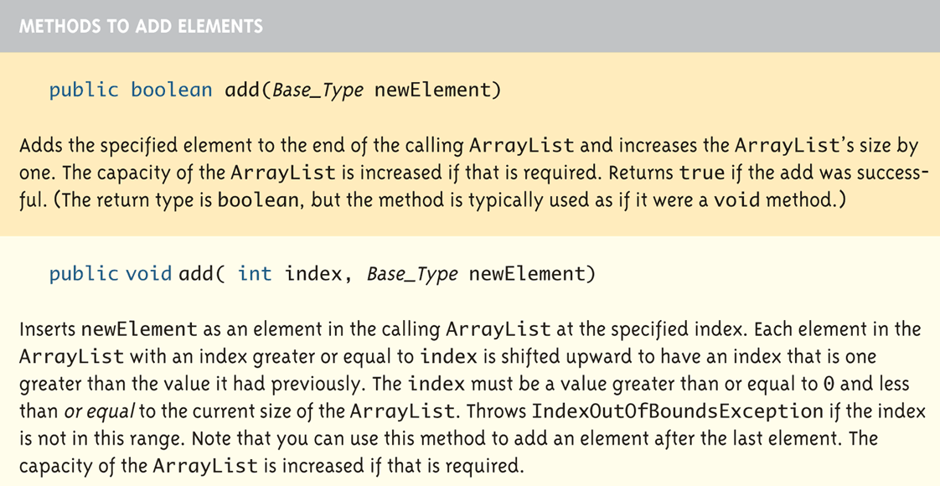
Methods in the Class ArrayList (4 of 12)
Display 14.1 Some Methods in the Class ArrayList

Slide 54
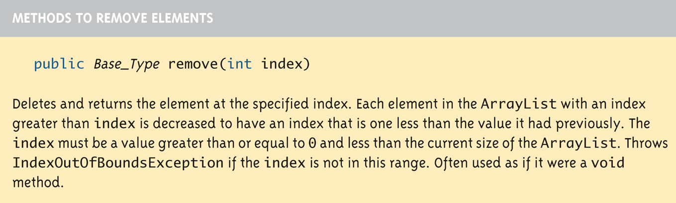
Methods in the Class ArrayList (5 of 12)
Display 14.1 Some Methods in the Class ArrayList

Slide 55
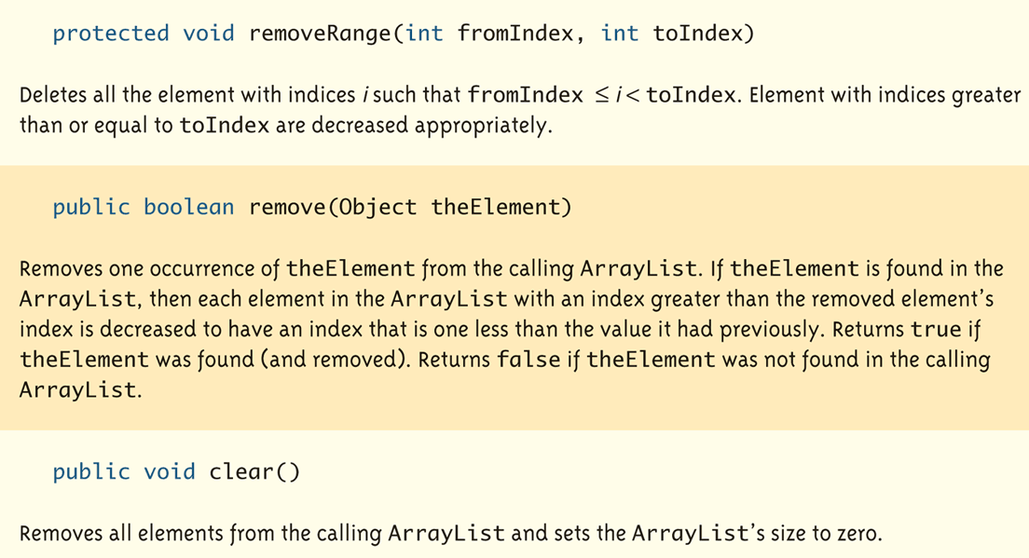
Methods in the Class ArrayList (6 of 12)
Display 14.1 Some Methods in the Class ArrayList

Slide 56
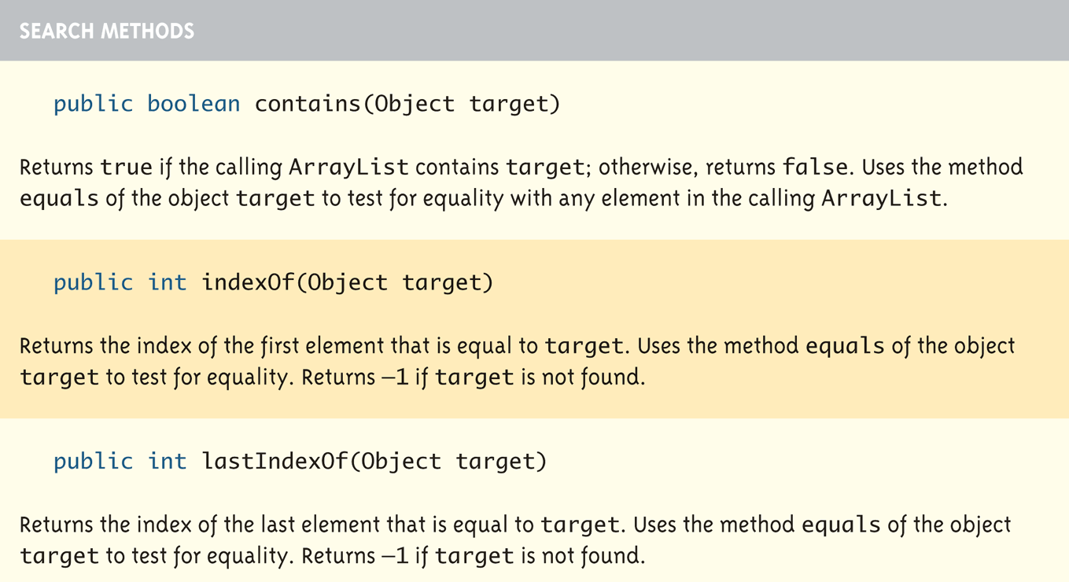
Methods in the Class ArrayList (7 of 12)
Display 14.1 Some Methods in the Class ArrayList

Slide 57
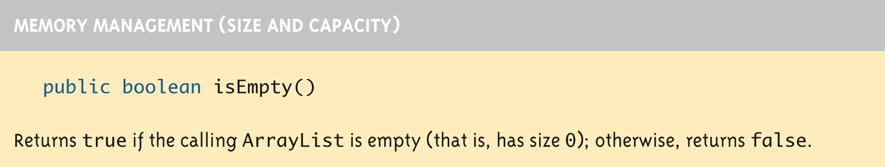
Methods in the Class ArrayList (8 of 12)
Display 14.1 Some Methods in the Class ArrayList

Slide 58
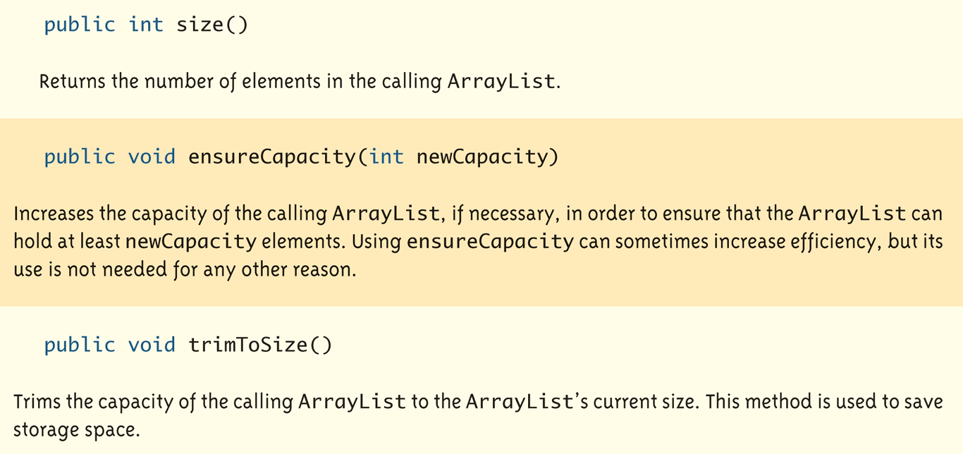
Methods in the Class ArrayList (9 of 12)
Display 14.1 Some Methods in the Class ArrayList

Slide 59
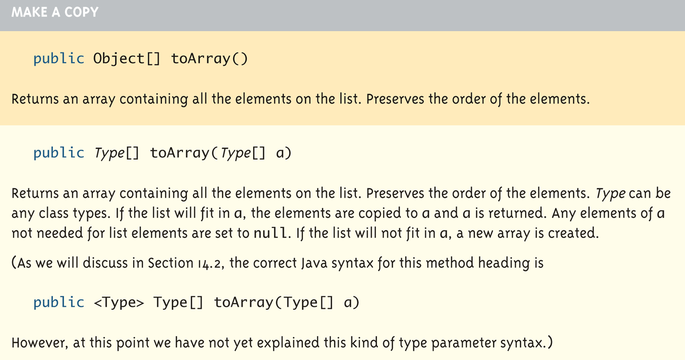
Methods in the Class ArrayList (10 of 12)
Display 14.1 Some Methods in the Class ArrayList

Slide 60
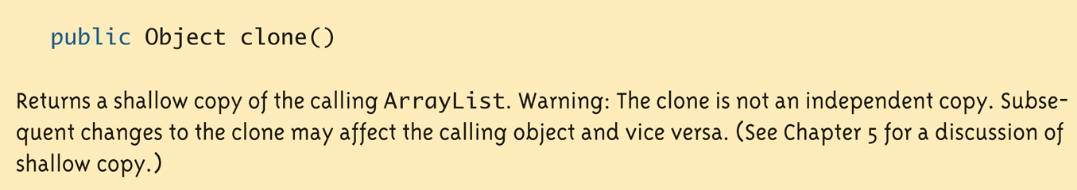
Methods in the Class ArrayList (11 of 12)
Display 14.1 Some Methods in the Class ArrayList

Slide 61
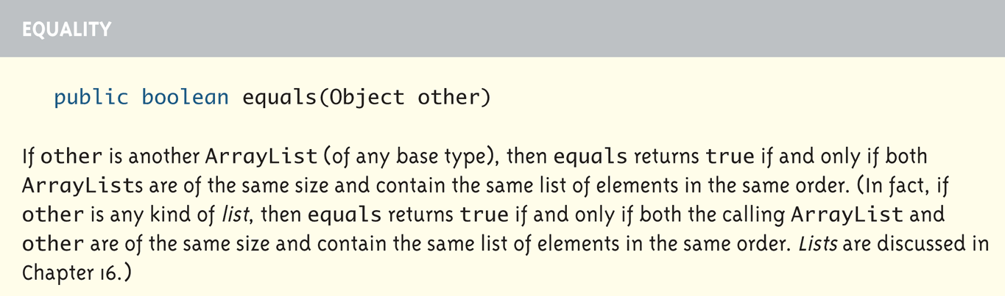
Methods in the Class ArrayList (12 of 12)
Display 14.1 Some Methods in the Class ArrayList

Slide 62
The "for each" Loop
The standard Java libraries include a number of collection classes
Classes whose objects store a collection of values
Ordinary for loops cannot cycle through the elements in a collection object
Unlike array elements, collection object elements are not normally associated with indices
However, there is a new kind of for loop, first available in Java 5.0, called a for-each loop or enhanced for loop
This kind of loop can cycle through each element in a collection even though the elements are not indexed

Slide 63
The "for each" Loop
Although an ordinary for loop cannot cycle through the elements of a collection class, an enhanced for loop can cycle through the elements of an array
The general syntax for a for-each loop statement used with an array is
for (ArrayBaseType VariableName : ArrayName)
Statement
The above for-each line should be read as "for each VariableName in ArrayName do the following:"
Note that VariableName must be declared within the for-each loop, not before
Note also that a colon (not a semicolon) is used after VariableName

Slide 64
The "For-Each" Loop
The for-each loop can make code cleaner and less error prone
If the indexed variable in a for loop is used only as a way to cycle through the elements, then it would be preferable to change it to a for-each loop
For example:
for (int i = 0; i < a.length; i++)
a[i] = 0.0;
Can be changed to:
for (double element : a)
element = 0.0;
Note that the for-each syntax is simpler and quite easy to understand

Slide 65
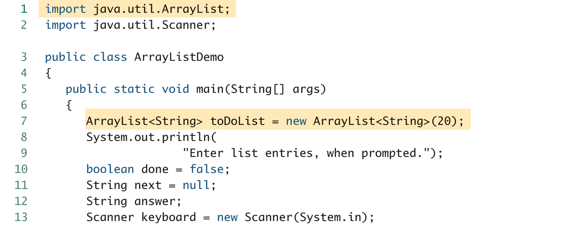
The “For Each” Loop (2 of 4)
Display 14.2 A for-each Loop Used with an ArrayList

Slide 66
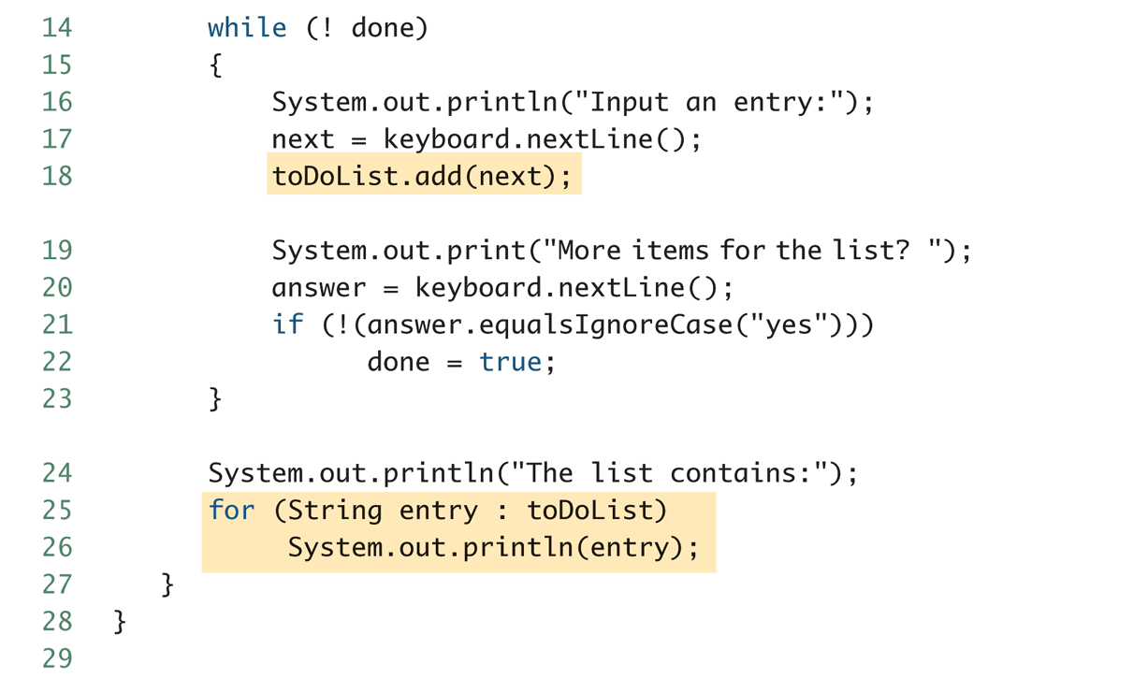
The “For Each” Loop (3 of 4)
Display 14.2 A for-each Loop Used with an ArrayList

Slide 67
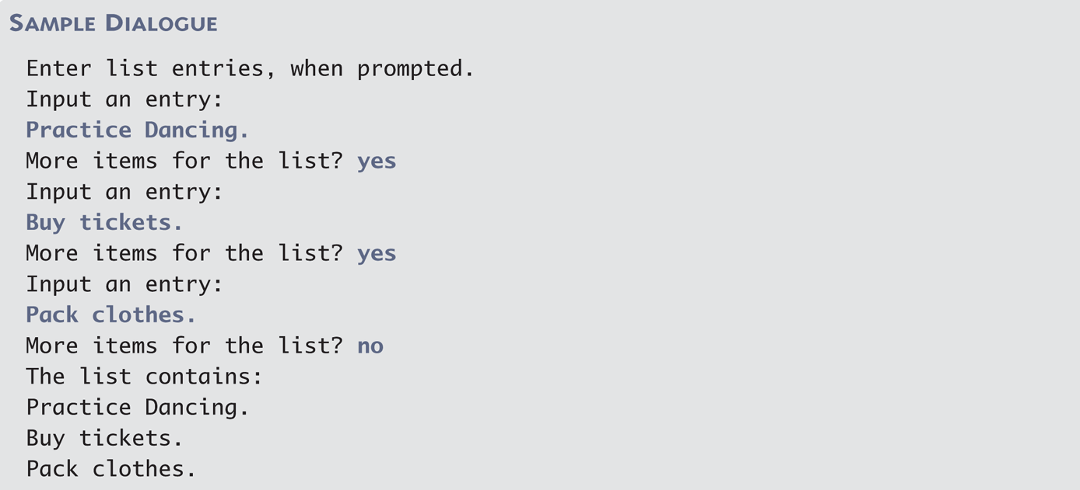
The “For Each” Loop (4 of 4)
Display 14.2 A for-each Loop Used with an ArrayList

Slide 68
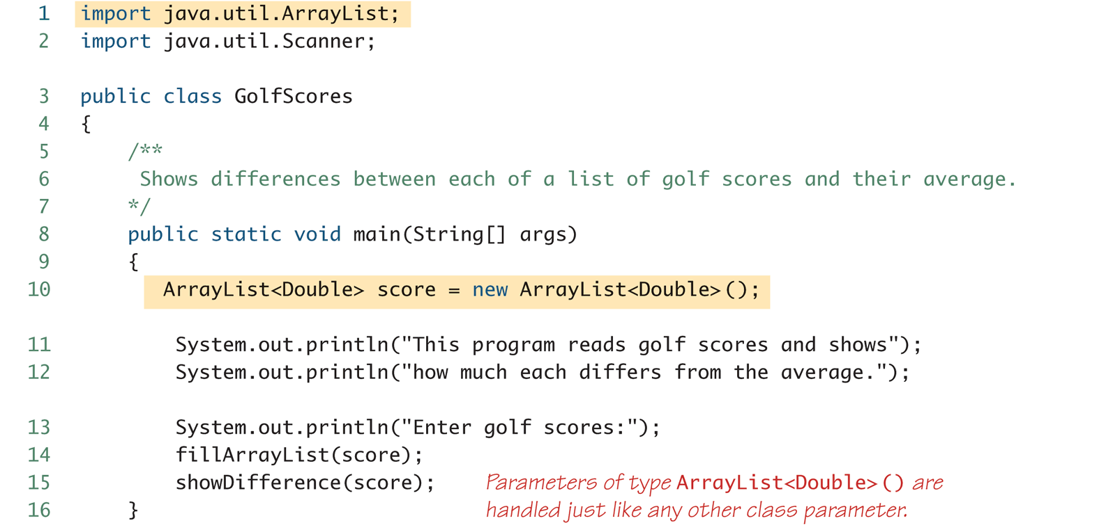
Golf Score Program (1 of 6)
Display 14.3 Golf Score Program

Slide 69
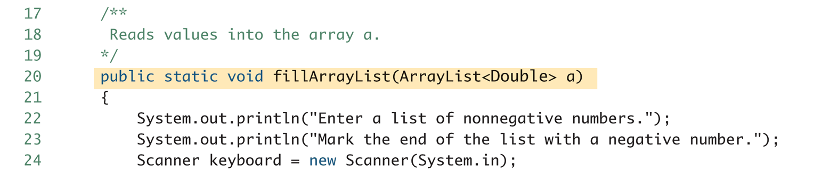
Golf Score Program (2 of 6)
Display 14.3 Golf Score Program

Slide 70
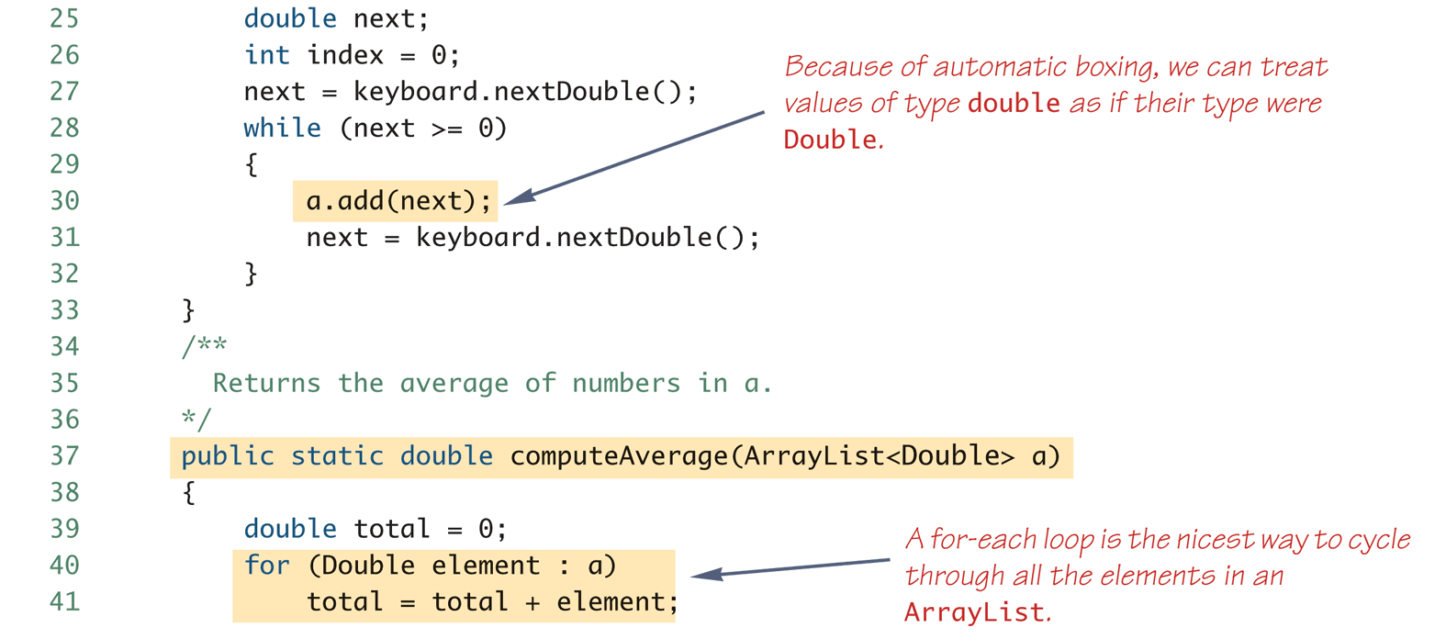
Golf Score Program (3 of 6)
Display 14.3 Golf Score Program

Slide 71
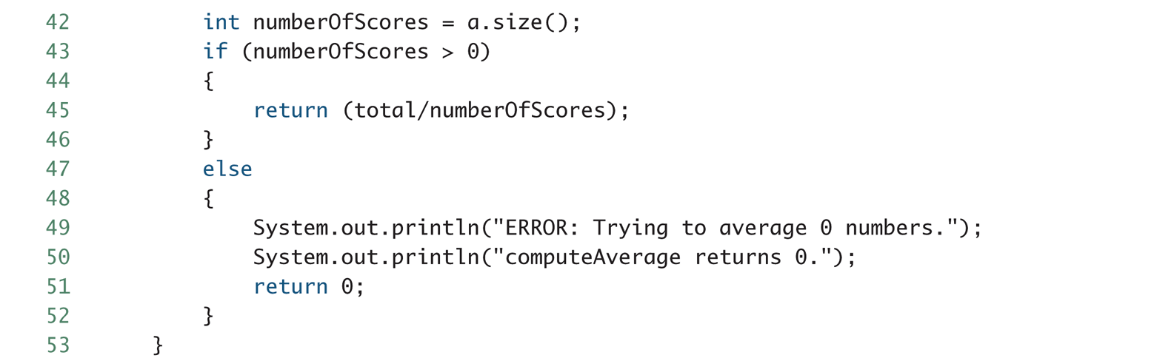
Golf Score Program (4 of 6)
Display 14.3 Golf Score Program

Slide 72
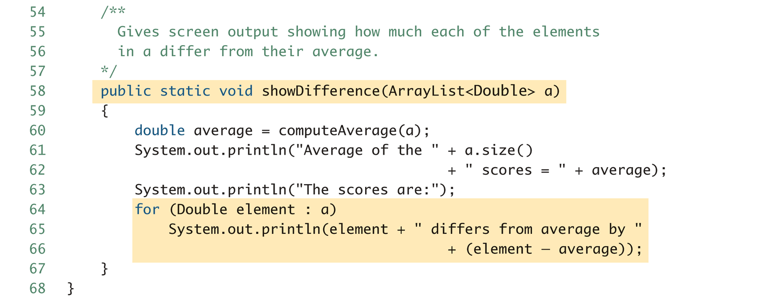
Golf Score Program (5 of 6)
Display 14.3 Golf Score Program

Slide 73
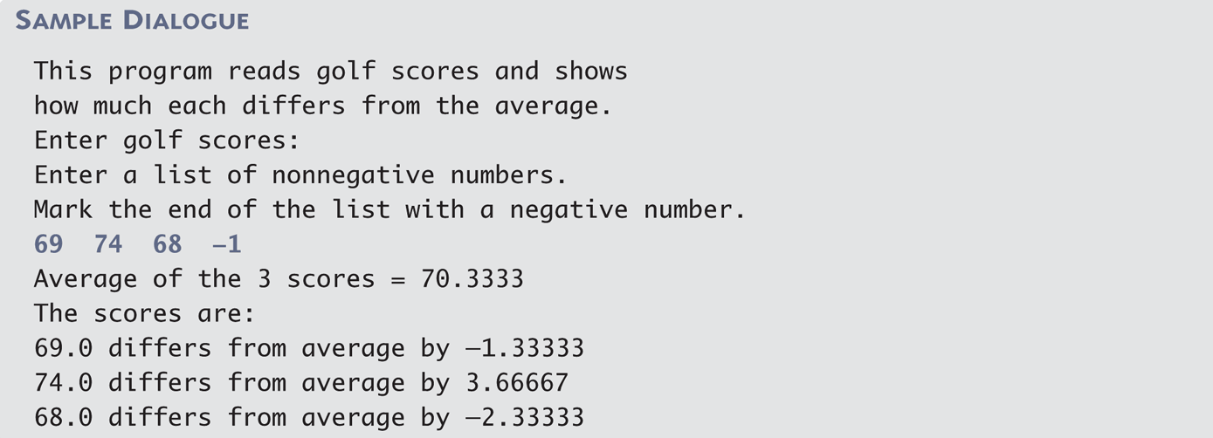
Golf Score Program (6 of 6)
Display 14.3 Golf Score Program

Slide 74
Enumerated Types
Starting with version 5.0, Java permits enumerated types
An enumerated type is a type in which all the values are given in a (typically) short list
The definition of an enumerated type is normally placed outside of all methods in the same place that named constants are defined:
enum TypeName {VALUE_1, VALUE_2, …, VALUE_N};
Note that a value of an enumerated type is a kind of named constant and so, by convention, is spelled with all uppercase letters
As with any other type, variables can be declared of an enumerated type

Slide 75
Enumerated Types Example
Given the following definition of an enumerated type:
enum WorkDay {MONDAY, TUESDAY, WEDNESDAY, THURSDAY, FRIDAY};
A variable of this type can be declared as follows:
WorkDay meetingDay, availableDay;
The value of a variable of this type can be set to one of the values listed in the definition of the type, or else to the special value null:
meetingDay = WorkDay.THURSDAY;
availableDay = null;

Slide 76
Enumerated Types Usage
Just like other types, variable of this type can be declared and initialized at the same time:
WorkDay meetingDay = WorkDay.THURSDAY;
Note that the value of an enumerated type must be prefaced with the name of the type
The value of a variable or constant of an enumerated type can be output using println
The code:
System.out.println(meetingDay);
Will produce the following output:
THURSDAY
As will the code:
System.out.println(WorkDay.THURSDAY);
Note that the type name WorkDay is not output

Slide 77
Enumerated Types Usage
Although they may look like String values, values of an enumerated type are not String values
However, they can be used for tasks which could be done by String values and, in some cases, work better
Using a String variable allows the possibility of setting the variable to a nonsense value
Using an enumerated type variable constrains the possible values for that variable
An error message will result if an attempt is made to give an enumerated type variable a value that is not defined for its type

Slide 78
Enumerated Types Usage
Two variables or constants of an enumerated type can be compared using the equals method or the == operator
However, the == operator has a nicer syntax
if (meetingDay == availableDay)
System.out.println("Meeting will be on schedule.");
if (meetingDay == WorkDay.THURSDAY)
System.out.println("Long weekend!);

Slide 79
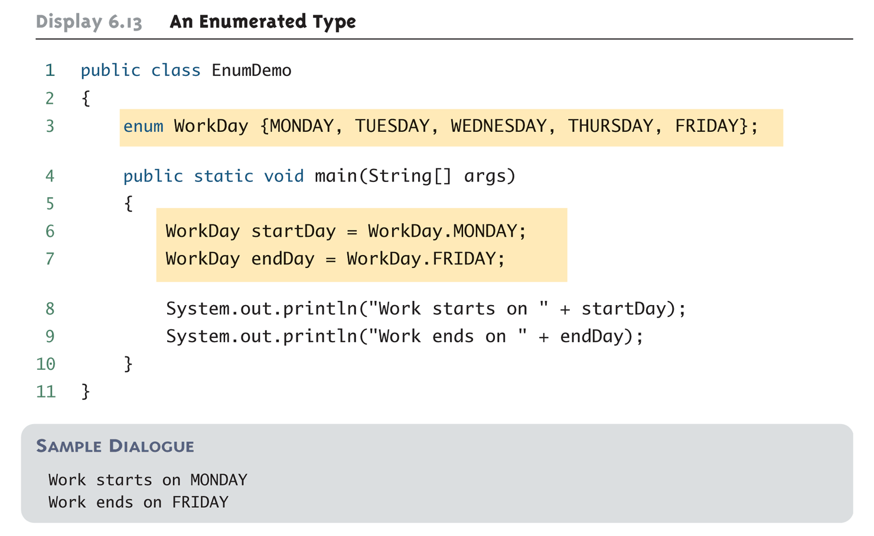
An Enumerated Type

Slide 80
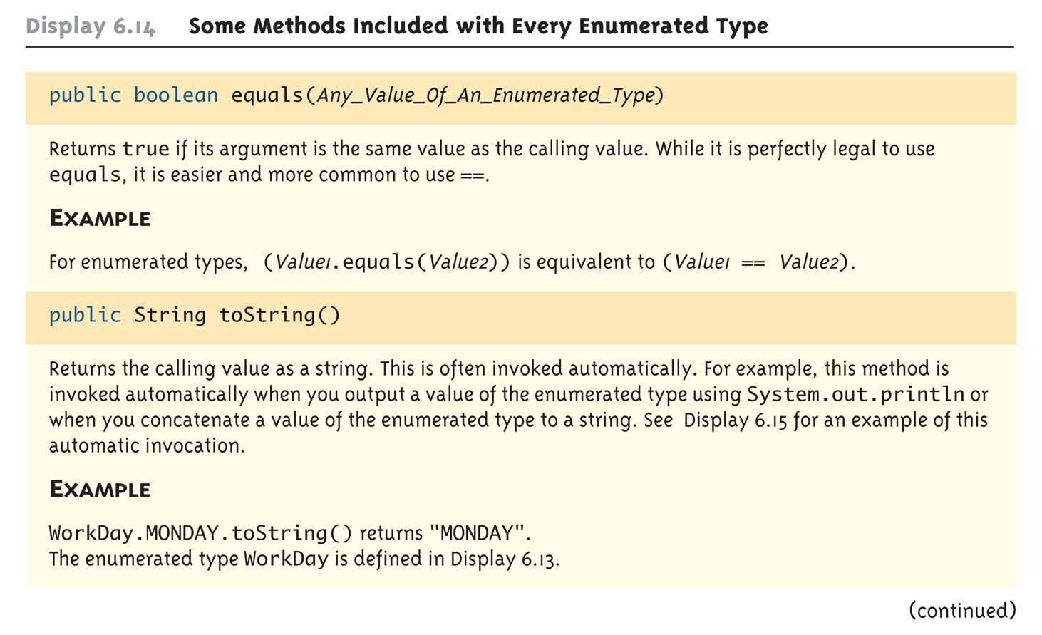
Some Methods Included with Every Enumerated Type (Part 1 of 3)

Slide 81
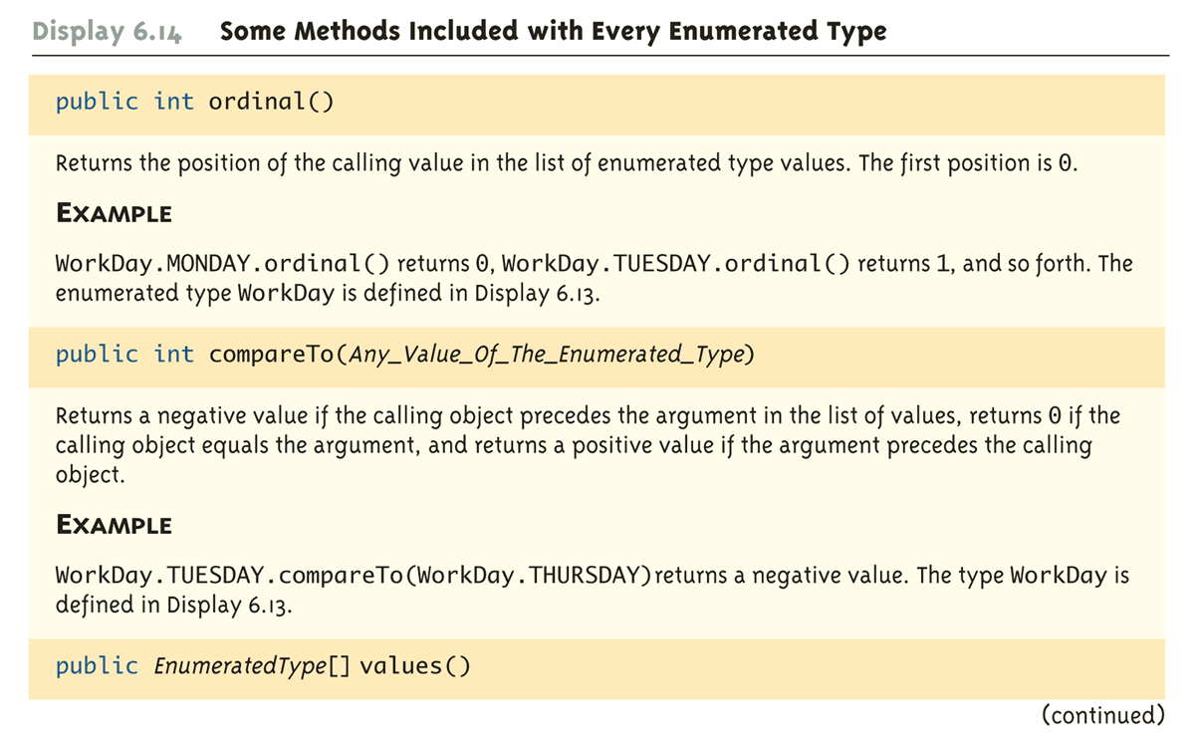
Some Methods Included with Every Enumerated Type (Part 2 of 3)

Slide 82
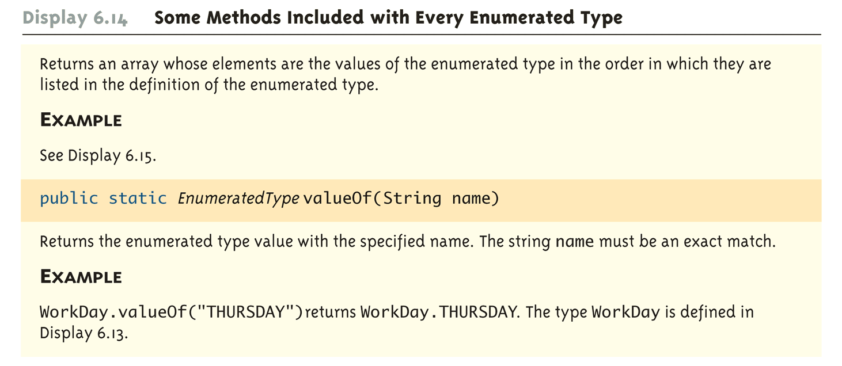
Some Methods Included with Every Enumerated Type (Part 3 of 3)

Slide 83
Programming Tip: Enumerated Types in switch Statements
Enumerated types can be used to control a switch statement
The switch control expression uses a variable of an enumerated type
Case labels are the unqualified values of the same enumerated type
The enumerated type control variable is set by using the static method valueOf to convert an input string to a value of the enumerated type
The input string must contain all upper case letters, or be converted to all upper case letters using the toUpperCase method

Slide 84
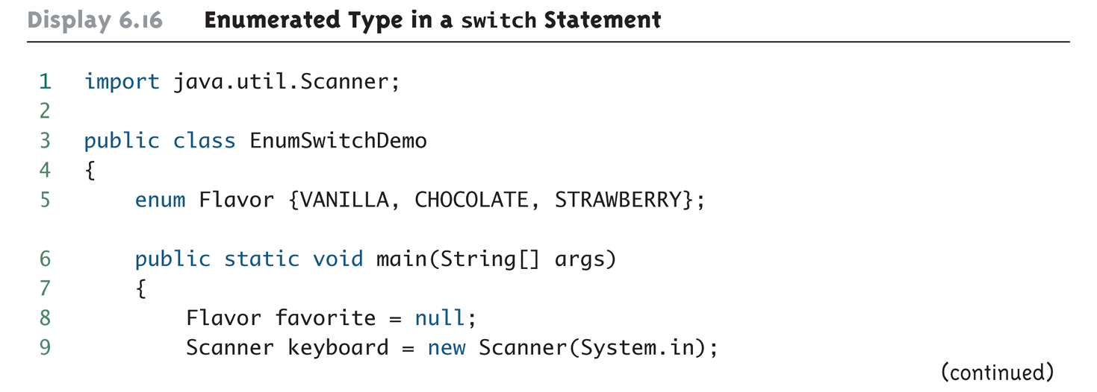
Enumerated Type in a switch Statement (Part 1 of 3)

Slide 85
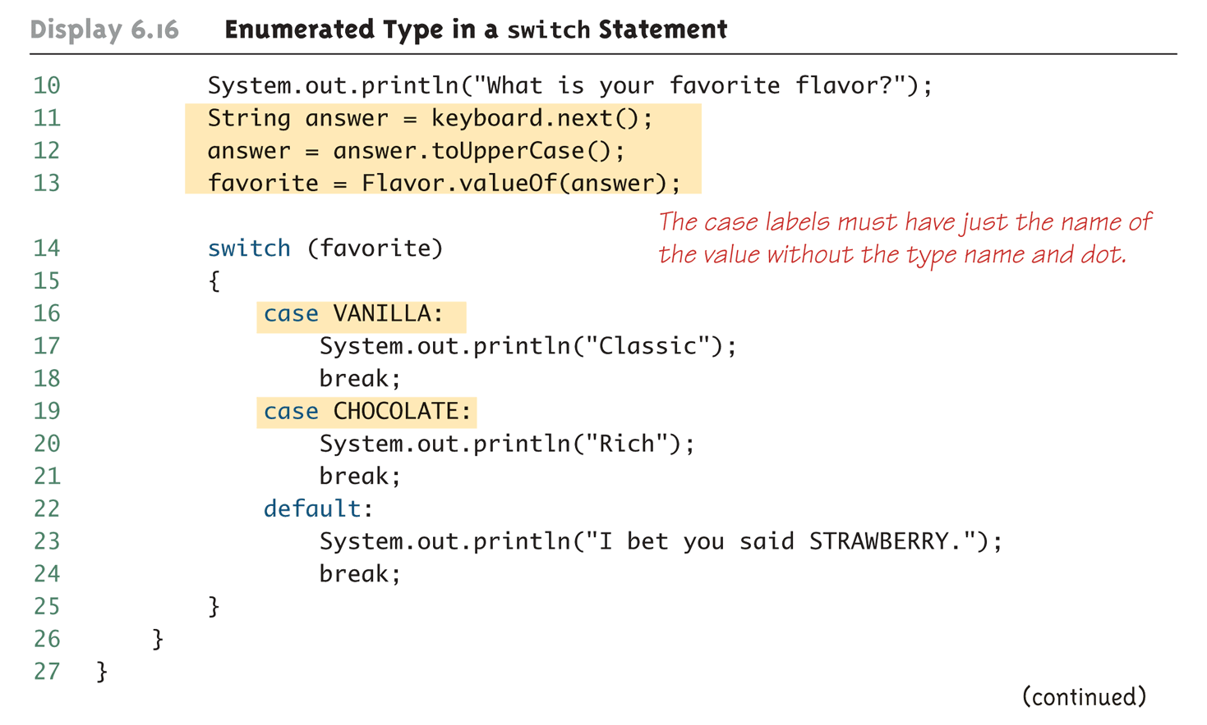
Enumerated Type in a switch Statement (Part 2 of 3)

Slide 86
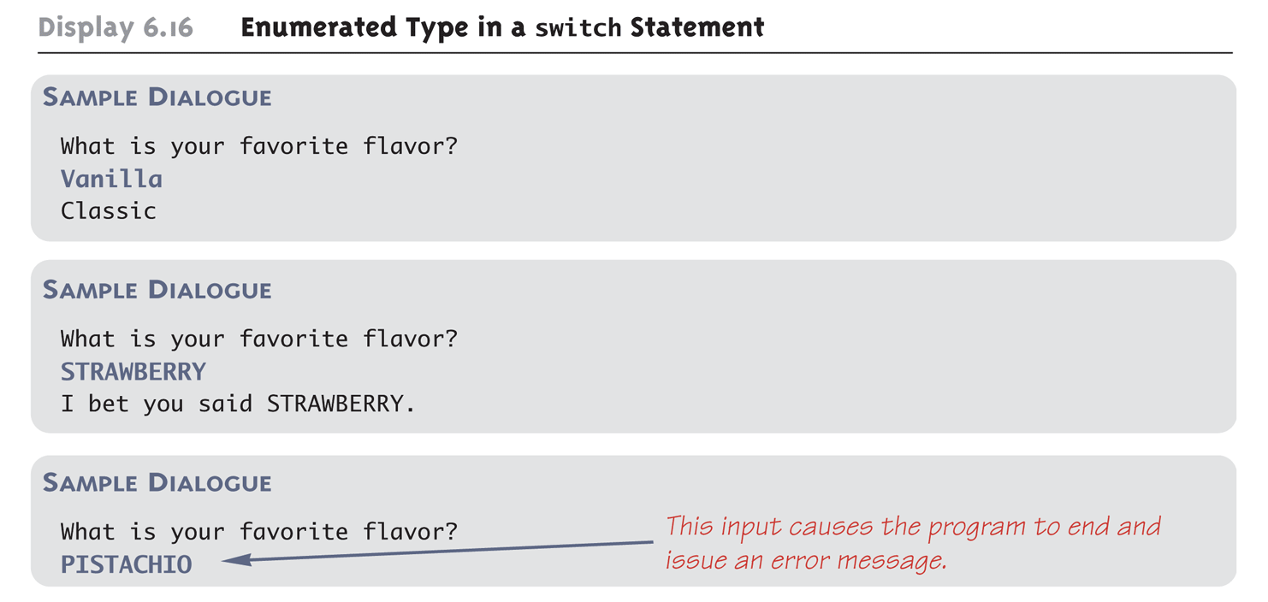
Enumerated Type in a switch Statement (Part 3 of 3)

Slide 87
int rand = Random.getRandomNumberGenerator().randomInt(1, numbers.size());

